Slide 1
National Stoma Quality Improvement Short Life Working Group
(NSQIG)
Final Report
Key Issues and Recommendations
Craig Stewart
Associate Nurse Director / Chair of NSQIG
NHS Ayrshire & Arran

Slide 2
Introduction
The National Stoma Quality Improvement Short Life Working Group (NSQIG) was commissioned by the NHS Scotland Executive Nurse Director Group (SEND) and established in February 2018.
The Scottish Deputy Nurse Director Group (SDNDG) provided governance and leadership to NSQIG through the chair Craig Stewart.
NSS provided support with project management and analyst funding
NSQIG membership includes regional key stakeholder representation from : HB stoma nurses, HB prescribing support, pharmacy, G.P representatives, Colorectal Surgeon, procurement and prescribing analyst support.
Wider engagement established with Directors of Pharmacy, Health Board Stoma Fora and commercial partners; British Healthcare Trade Association (BHTA), Community Pharmacy Scotland and Scottish Stoma Forum
NSQIG has adopted a values based approach to identify how stoma care is optimised by delivering the best possible patient outcomes in the most efficient way to ensure resources are allocated for maximum clinical and financial value.
The aim of NSQIG is to identify, prioritise and progress areas of work requiring a national “Once for Scotland” approach, complementing NHS Boards stoma quality and efficiency activities aligned to the stoma quality and cost effectiveness national review (2016).

Slide 3






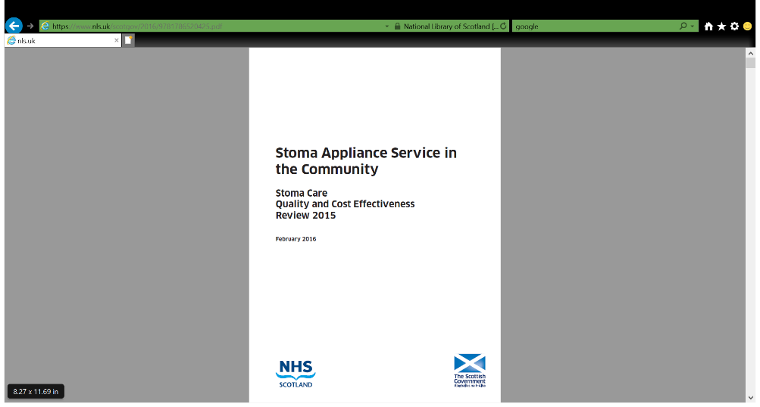
Strategic Context: Key Policy Drivers

Slide 4
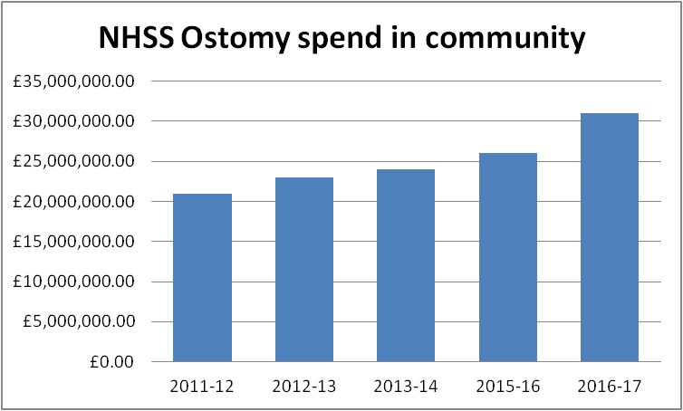
Case for Change in Stoma Product Prescribing
65% increase in stoma expenditure over 5 years: related to increasing volume
10% increase in patient numbers over the same period
Stoma- related morbidity & commercial influence on prescribing are related to increase in product use

Slide 5
What we did
Three sub groups were identified to deliver on key project objectives:
Data Sub group
Formulary Sub group
Process Sub group
An addition subgroup was developed with commercial partners BHTA and CPS
Subgroup activity involved scoping surveys to identify
  Prescribing and clinical data intelligence & collation
  Commercial partner data collation
  Review of HB stoma formularies for guidance & structure

Slide 6
What we found
Variation in how stoma data is measured across NHSS
Variation in data capture across commercial partners: DACs / CP
Variation in content & structure of HB Stoma Formularies
Commercial influence on product prescribing
Lack of clinical data extractability:
  Stoma morbidity : % of leakage , % of skin problems
  % of patients who are self caring
  % of patients who require support : frail , elderly , co-morbidity
Stoma Population ( identified through NSQIG Data )
  NHSS Stoma Patients: 19,123
  New Patients : 2200 pa
  56% have permanent stoma = 11,000 patients = long term patients
  76% of prescribing costs are in long term pt. group
  Over/ under use across all HBs : may suggest undetected stoma problems
  Cost per Treated Patient increases in patients >50yrs: majority of stoma population.
90% prescribing via GPs & lack of prescribing scrutiny
Dispensing : 80% DACs 20% CP : DACs have highest CPTP across all stoma types

Slide 7
NSQIG Key Messages
Concern that under and over use of stoma products as a result of stoma care related problems or morbidity, largely occurs as an un-detected clinical event across Scotland. These negatively impact on the quality of life for stoma patients.
Recognition and reduction of unwarranted variation and waste was an overarching theme from the work of NSQIG, which is supported by key health and social care strategic policies.
There is evidence of there being a distinct gap in the format and reporting of stoma prescribing data across NHS Scotland Boards. Industry partners have significantly more data which is not being shared consistently. This is a compounding factor.
Improvements in patient monitoring, assessment of product effectiveness and efficiency of stoma prescribing will support improved patient care and reduce waste and unwarranted variation.
Reliance on General Practitioner stoma prescribing has been noted as both a workload issue in primary care and a contributory factor in prescribing variance of stoma products and accessories
There is need for more integrated leadership across the nursing and pharmacy professions both locally and nationally.

Slide 8
NSQIG DELIVERABLES
Development of an agreed suite of Data Metrics for strategic level Health Board Stoma reports, piloted across 4 HB’s
Development of National Stoma Prescribing Guidance to act as a pragmatic Rx aid and support equity of practice
Appliance & Accessory Flow charts to identify overuse and support early referral for clinical review
Alternative models to GP prescribing identified : to be evaluated within Proof of Concept Testing

Slide 9
Benefits
CLINICAL
  National stoma data set to capture adverse events to drive improved patient outcomes
  Variance monitoring & benchmarking across HBs
FINANCIAL
  Improved prescribing & scrutiny has potential to reduce expenditure
  Target 20% reduction in expenditure = £6.2 million savings per annum with current £31million spend
ENVIROMENTAL
  Reduction in product volumes with appropriate product use has significant environmental impact in reduced plastic waste & landfill
Delivering Value-Based Stoma Care

Slide 10
Recommendations
In total 15 recommendations have been identified from the work of NSQIG.
The recommendations identified within the following themes:
Leadership, Governance and Accountability
Data for Assurance and Improvement
Prescribing Guidance
Stoma Product Access Models

Slide 11
SEND Support to take forward
Agree process for Ratification of report
Support for Phase 2 & National Leadership to:
  Develop minimum data set/ digital solutions to capture clinical interventions & patient outcomes
  Identify process for implementation of serial prescribing
  Develop Proof of Concept testing of PECOS Model
  Build in QI measures to capture patient experience, clinical outcomes, financial & environmental benefits from reduction of unwarranted variation &waste
  Ratification and implementation of National Stoma Prescribing Guidance
  Implementation of strategic level stoma prescribing data reports
  Support and maximise stoma nurse workforce contribution

Slide 12
Actions to take forward

